Slide 1
Decision Tree Learning Algorithms
FORREST BANKSTON

Slide 2
Outline
Introduction/Review
ID3
C4.5
CART
CHAID
Python Tests
New Proposal

Slide 3
Introduction/Review
Decision Trees are one of the most popular decision-making models used not only in machine learning but also in fields like engineering, business, and law
Decision trees are used for many reasons such as their low time complexity and accuracy when compared to other machine learning algorithms but the main thing that makes decision trees stand out is their simplicity to interpret and their familiarity
Most people have worked with a decision tree in some shape or form and will have no problem interpreting them from a basic standpoint
There are several popular decision tree learning algorithms that have been proposed such as the ID3, C4.5, CART, and more that we will discuss

Slide 4
Introduction/Review
Decision trees typically follow a tree-like structure that is sorted from the top-down from the root to the leaf nodes.
Each of the nodes in the tree will represent a test of an attribute of the instance, and the branches will represent a possible value of the attribute
Each leaf at the bottom of the tree represents classification
The root node is topmost node, internal nodes are nodes that have a child node, and terminal nodes are nodes that do not have any children.
The two simple examples in the next slide only use and predict categorical data, but keep in mind that depending on the selected algorithm, quantitative values can be used/predicted as well

Slide 5
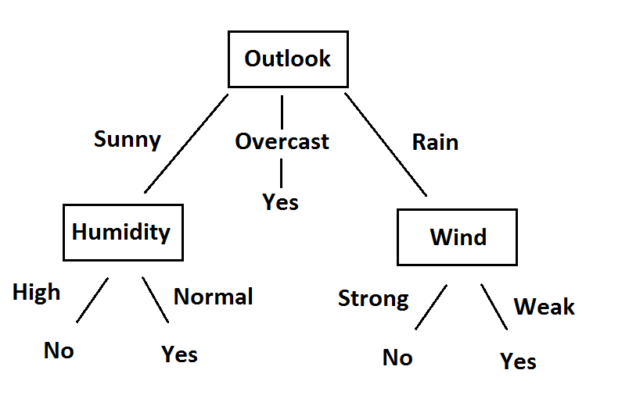
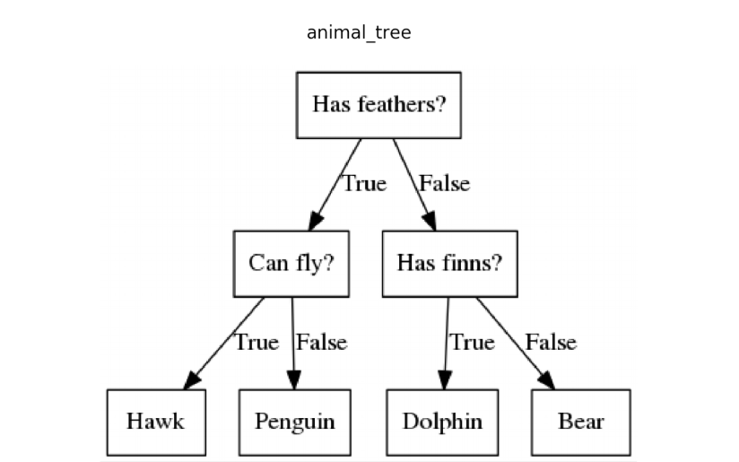
Left is Binary Classification, Right is Multiclass classification

Slide 6
ID3 - Iterative Dichotomiser 3
ID3 has an iterative structure, meaning that it will execute a sequence of statements repeatedly as long as some condition is true, and then terminate
In this algorithm, a subset of the training set is chosen at random and a decision tree is formed from this subset that will correctly classify all of the objects in the subset
Then, all other objects in the training set will be classified using this tree
If the tree is correct for all of the objects, then it will be correct for the entire training set and the process can terminate
If the tree is not correct for all the objects, then a selection will be made of the incorrectly classified objects to add to the subset, and the process will continue

Slide 7
ID3 – Information Gain/Entropy
In other words: The ID3 algorithm will examine all of the possible features and choose the one that will maximize gain (A), form a tree, and then recursively do this same process until subtrees are formed for all of the subsets
How well a given attribute maximizes gain by separating the training set is known as information gain
The feature that has the most information gain will then be used as the root node so that it will be tested first and keep the decision tree as simple as possible
Keeping a decision tree simple is extremely important to preserve its interoperability

Slide 8
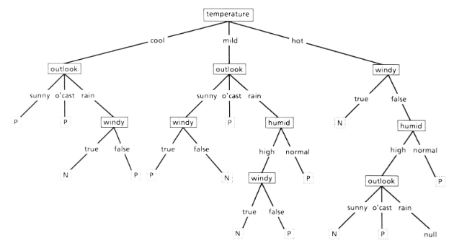
A Complex Decision Tree (still works)
This decision tree still works for the data but fails to capture and represent a meaningful and simple to interpret relationship between the features and the target outcome
We would much prefer to take the Occam’s razor approach and pick the simplest tree

Slide 9

ID3 – Information Gain/Entropy
Entropy is a measurement of disorder. In this context it is used as a measurement of uncertainty to measure the information gain of a node
A dataset of only blues would have very low (in fact, zero) entropy. However, a dataset of mixed blues, greens, and reds would have relatively high entropy:
Low entropy typically means the test will give you an accurate prediction, meaning it has a good information gain
Pi = probability of a class

Slide 10

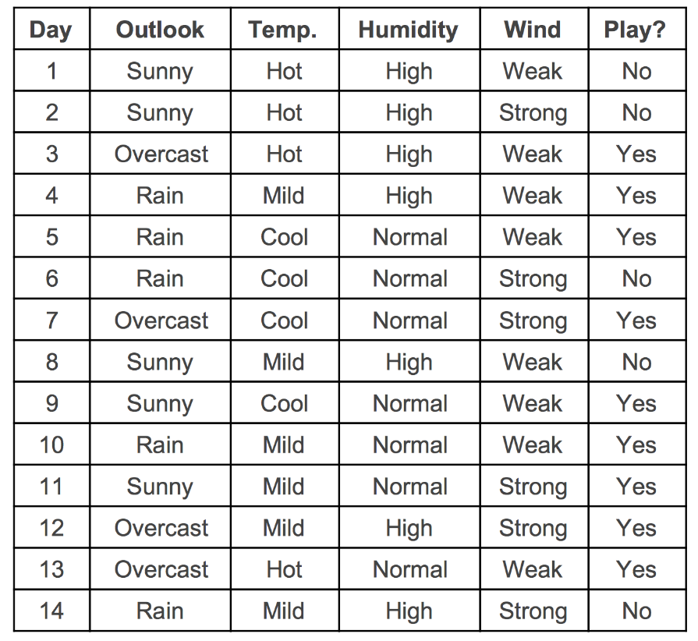


Using the simple play tennis/golf dataset, we have 9 objects of class P(Yes) and 5 of class N(No)
Next consider the Outlook feature with the values Sunny, Overcast, and Rain. We calculate the amount of P’s and N’s from each specific feature value respectively
Now that we have calculated the entropy of outlook, we can subtract it from the initial entropy to see the gain from outlook, with results from the other features below it
gain(outlook) = 0.940 - E(outlook) = 0.246 bits
gain(temperature) = 0.029 bits
gain(humidity) = 0.151 bits
gain(windy) = 0.048 bits

Slide 11
ID3
Because outlook results in the highest information gain, it will be selected as the root node of the tree
Then, the objects would be divided into subsets according to their values of the outlook feature and a decision tree for each subset would be made in a similar fashion
ID3 is rather straightforward and its purpose is to construct an accurate decision tree with a low time complexity for the given dataset
This early algorithm is effective for simpler data sets but has a few key issues holding it back

Slide 12
ID3 Problems
ID3 gets a lot of its efficiency due to it being greedy: It selects a test from the information gain and then never explores other choices
The author of ID3 claims that this will always lead to a decision tree, but it will not always be the best decision tree possible
Therefore the ID3 algorithm is capable of achieving local optimum but not global optimum
The iterative nature of ID3 means it will keep going until a condition is satisfied and it terminates
This can result in larger than necessary decision trees, or decision trees that very much overfit the data

Slide 13
C4.5
The C4.5 algorithm was developed by the same researcher who made ID3 with the goal of keeping the advantageous properties of ID3 while providing a solution for its main faults
The first new attribute of C4.5 is that it used information gain ratio instead of information gain
Information gain used in ID3 highly prefers features with many possible values because it can then split the data into many small subsets
This is not good because these small subsets will tend to have no correlation between the target feature and the descriptive feature and make the decision tree more complex

Slide 14
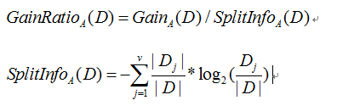
C4.5 – Information Gain Ratio
To find gain ratio, use a split information value that represents the potential information gained by splitting the training data set D into v partitions that correspond to v outcomes on attribute A
Of course we will then select the feature with maximum gain ratio as the root node or the splitting attribute
The information gain ratio criterion is very robust and typically gives a better choice of test than the previous information gain criterion

Slide 15
C4.5 - Innovations
Besides using information gain ratio, there are a few more innovations from ID3 to C4.5
C4.5 is capable of working with not only categorical but also quantitative(numerical) data
C4.5 is also capable of handling missing/unknown feature values by assuming that unknown test outcomes are distributed probabilistically according to known outcomes
Both of these innovations are very useful for working with real-world data sets, as they will oftentimes have quantitative or missing data

Slide 16
C4.5 - Pruning
As stated, ID3 can oftentimes infer much more structure than is justified by the training cases which will result in overfitting
To solve this, pruning was introduced and is divided between pre-pruning and post-pruning
Pre-pruning is not allowing the tree to grow to its full length, usually set by some maximum tree depth
Pre-pruning is initially very attractive because it doesn’t waste time building useless structure, but in practice it’s very hard to set a consistent max depth

Slide 17
C4.5 - Pruning
Post-pruning more common and is letting the tree grow to its full length, and then removing some of its structure that proves to be less useful
Error rate is used as a measurement to compare the error rate in predictions made by a decision tree that has a given subtree, and a decision tree after the subtree is pruned
To measure error rate, some portion of the training set will be set aside to serve as a validation dataset (form of cross-validation)
Both pre/post-pruning were tested for C4.5 but ultimately post-pruning was decided to be used

Slide 18
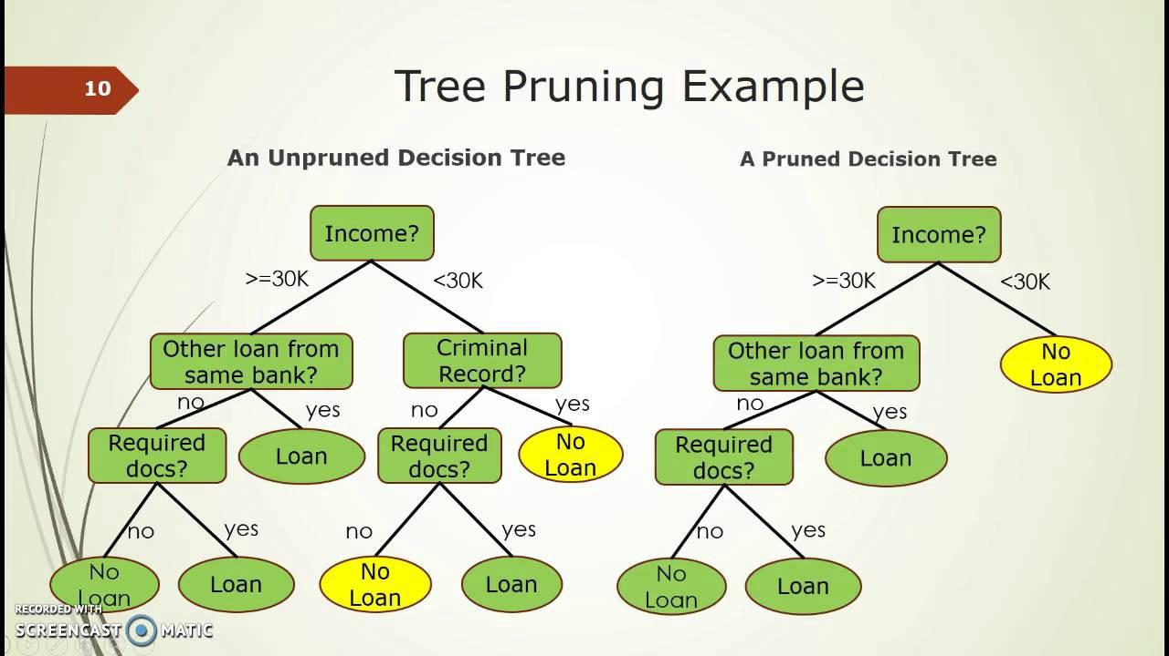
We prune the right subtree because we assume it will almost always result in NO, but this could be incorrect which is why we cross-validate

Slide 19
C4.5 – C5.0
C5.0 is rather new but has been marketed commercially and offers a good number of improvements over its predecessor (C4.5 still very popular because it is free)
C5.0 doesn’t bring many brand-new innovations over C4.5 besides support for several machine learning extensions such as random forests and AdaBoost
Instead, C5.0 has mostly improved its performance in all areas such as speed, memory usage, and generally producing small trees

Slide 20
CART – Classification/Regression Trees
CART algorithms can produce either a classification or a regression tree based upon if the target variable is categorial or quantitative respectively
A classification tree is used to sort data into different classes (yes, no) while a regression tree would be used to predict values (property price)
CART is very similar to C4.5 but has some key differences such as being able to predict quantitative data and not just use it for prediction
C4.5 may have trees with multiple outcomes, but trees in CART are always binary

Slide 21
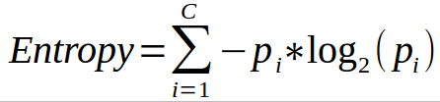
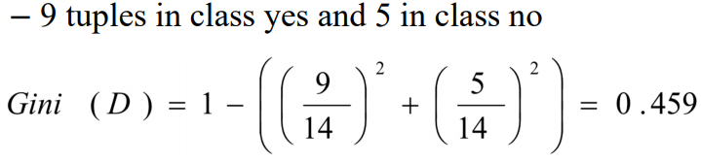
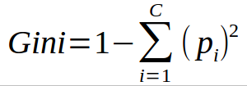
CART – Gini impurity
The main notable difference between ID3 and CART is that CART will not use information gain from entropy but instead use Gini impurity as a splitting criterion
Entropy will multiply the probability of the class times log₂ of that class’s probability
Gini impurity instead is calculated by subtracting the sum of the squared probabilities of each class from 1
Low impurity means we can gain a lot of info from a particular feature

Slide 22
CART – Gini impurity
Entropy is typically more computationally taxing due to the log in the equation
This will can possibly give Gini an advantage on larger datasets that are already computationally taxing to begin with
Data Analysts/Scientists should generally experiment with both information gain and Gini impurity to find the right measurement for whatever project they are working on
An optimized version of CART is used in the scikit-learn decision tree package

Slide 23
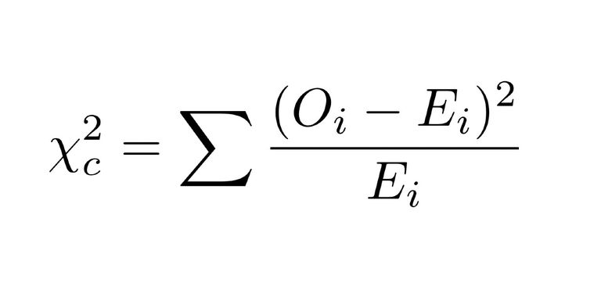
CHAID - Chi-Square automatic interaction detector
CHAID uses Chi-squared and was actually proposed before the other algorithms we have discussed, but probably sees the least use overall
Chi-squared is another measurement for the significance of a feature similar to information gain/Gini impurity
The higher the value of chi-square, the more information we can gain from a feature
X² = Chi squared
O = Observed Value
E = Expected Value

Slide 24
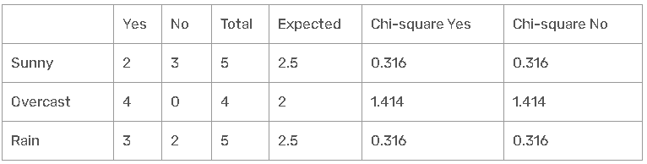
CHAID – Play Tennis/Golf Example
Outlook has 3 classes: sunny, rain, and overcast, and there are two possible decisions of yes and no
The total column is the total sum of decisions for each row and the expected column = total/2 because there are two decision classes
√(( 2 - 2.5 )² / 2.5 ) = 0.316 where the actual is 2 and expected is 2.5
√(( 3 - 2.5 )² / 2.5 ) = 0.316
Add up all the values to find chi-square for outlook: 0.316 + 0.316 + 1.414 + 1.414 + 0.316 + 0.316 = 4.092
Similar analysis gives: Temperature = 2.569 Humidity = 3.207 Wind = 1.604
Therefore, we will select outlook as the root node because it has the highest chi-square value

Slide 25
CHAID
As stated, CHAID was proposed before ID3, C4.5, and CART, and also is not nearly as popular in the field of Machine Learning as these other methods
CHAID uses pre-pruning as its strategy to prevent overfitting
In theory, this should result in the CHAID algorithm being efficient in terms of performance but lacking in accuracy/inconsistent

Slide 26
Python Tests
I used the chefboost Python library to do test implementations ID3, C4.5, CART, and CHAID
This is a very convenient library that can load a dataset through a pandas data frame and create a decision tree classifier based on the choice of decision tree algorithm
The binary classification Breast Cancer Wisconsin data set was used to test these algorithms
ID3 technically could not be applied to this dataset considering it has many quantitative values, but C4.5 is expected to have similar results

Slide 27
Python Tests
Simple implementation of C4.5 with chefboost
The algorithm can be changed by editing the corresponding parameter in the “config” line
C4.5 Results:
Accuracy: 98.94551845342707 % on 569 instances
finished in 61.1552369594574 seconds
from chefboost import Chefboost as chef import pandas as pd df = pd.read_csv("tests/dataset/cancerData.csv") config = {'algorithm': 'C4.5'} model = chef.fit(df.copy(), config)

Slide 28
Python Tests
CART Results:
Accuracy: 100.0 % on 569 instances
finished in 30.266298532485962 seconds
CHAID Results:
Accuracy: 99.64850615114236 % on 569 instances
finished in 40.133530139923096 seconds

Slide 29
Python Tests
As you can see, I theoretically received the best results from the CART algorithm which classified every case correctly with an execution time of roughly 30 seconds (possibly overfitting since 100% accuracy)
The CHAID algorithm received a fairly similar result, only misclassifying two cases while executing ten seconds slower
C4.5 definitely performed the worst in this case by misclassifying 6 cases and taking twice as long to execute as CART at 60 seconds

Slide 30
New Proposal – Objectives
Use what I have learned from this course/research to implement my own code from scratch without using (almost) any libraries to actually recreate the process of a decision tree classifier in python
The decision tree classifier should be customizable
The decision tree classifier should be comparable in accuracy/speed to be competitive with other popular machine learning libraries

Slide 31
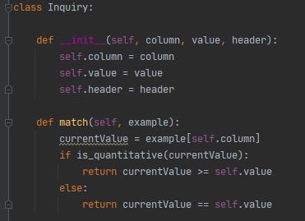
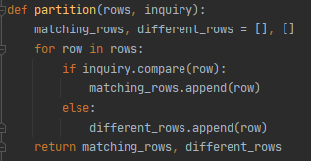
New Proposal - Examples
Decision trees must make inquiries or ask questions to find how to split the data. Here we find the questions we can ask (features) and see if they are quantitative or categorical
Partition the data into lists of matching features so we can calculate impurity en masse

Slide 32
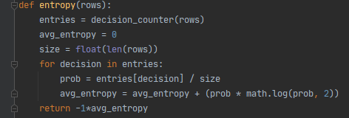
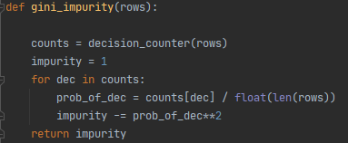

New Proposal - Examples
Calculating entropy, Gini impurity, and information gain

Slide 33
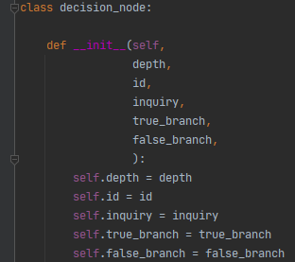
New Proposal - Examples
Class defining a decision tree node
scikit learn templates helped to get a general idea of how to do some of the class definitions

Slide 34
New Proposal – Results
Running my decision tree classifier on the same breast cancer dataset yielded solid results
Accuracy: 96.0% on 569 instances
Execution Time: 0:01:34.767576
Also tested on popular Machine Learning cars dataset to predict customer acceptability of a car – More instances but less features
Accuracy: 98.0% on 1729 instances
Execution Time: 0:00:17.153981

Slide 35
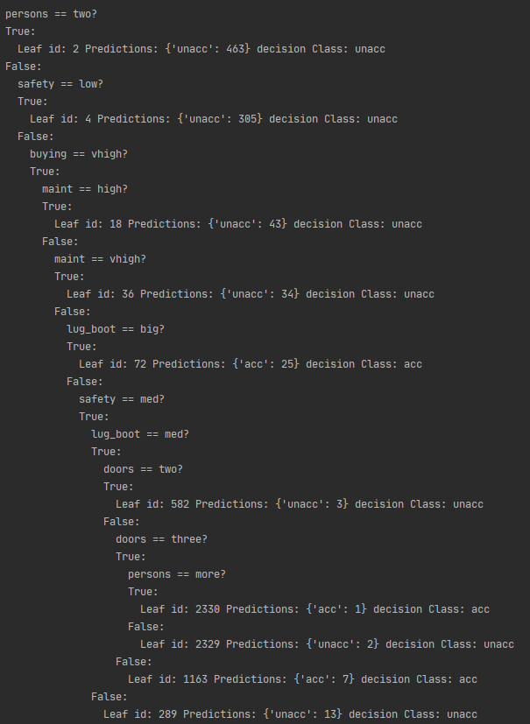

Slide 36
New Proposal – Did We Meet Our Goals?
Use what I have learned from this course/research to implement my own code from scratch without using (almost) any libraries to actually recreate the process of a decision tree classifier in python – Only used pandas for loading in the dataset, and scikit learn for cross-validation
The decision tree classifier should be customizable – Somewhat customizable in different ways, and not that easily
The decision tree classifier should be comparable in accuracy/speed to be competitive with other popular machine learning libraries – Accuracy is good, decision tree building process is good, post-pruning could be improved

